Slide 1
Ideate and Implement a System to Enhance the Quality of Education in Rural Areas
CSE7101- Capstone Project
Review-1
Batch Number:
Under the Supervision of,
Mrs. Monisha Gupta
Professor / Associate Professor / Assistant Professor
School of Computer Science and Engineering
Presidency University
Roll Number | Student Name
20221IST0009 | YASHWITHA T
20221IST0011 | GUDDITI YASHWANTH KUMAR
20221IST0036 | VARSHA B
Name of the Program: B.TECH
Name of the HoD: Dr. Pallavi R
Name of the Program Project Coordinator: Ms. Benitha Christinal J
Name of the School Project Coordinators: Dr. Sampath A K , Dr. Geetha A

Slide 2
Problem Statement Number: PSCS_32
Organization: Government of Kerala
Category (Hardware / Software / Both) : Software
Problem Description:
Ideate and implement a system to enhance the quality of education in rural areas. The aim of the system is not only to improve literacy rates but also to strengthen the overall learning experience for rural students. This includes developing their communication skills, enhancing subject knowledge, and providing access to modern educational resources. The system will focus on bridging the gap between urban and rural education by offering both online and offline learning opportunities. It will also promote skill development, mentorship, and awareness about government schemes, ultimately contributing to the personal and professional growth of the targeted community.

Slide 3
Objectives
To develop a web-based learning system for rural students.
To provide educational content offline without internet dependency.
To allow teachers to upload lessons and quizzes easily.
To enable students to access lessons and take tests on any device.
To track student progress and show reports through charts.
To make the system low-cost, simple, and easy to use.
To support learning even in areas with limited electricity and network.

Slide 4
Background and Related work for title Selection
Background
Lack of access to quality study material
Limited availability of skilled teachers and mentors
Poor internet connectivity
Low awareness about government schemes and employment opportunities
SDG 4: Ensure inclusive and equitable quality education for all
SDG 8: Promote sustained, inclusive economic growth and employment
.

Slide 5
Background and Related work for title Selection (contd….)
Related Work
DIKSHA (Govt. of India)
Provides digital resources for teachers and students, but lacks personalized mentoring and offline support.
Khan Academy
Offers high-quality video lessons, but requires strong internet connectivity and does not support regional languages.
Digital Kerala Mission
Aims for digital literacy, but is not fully integrated with career guidance, scholarships, or mentorship systems.

Slide 6
Analysis of Problem Statement
Challenges in Rural Education:
Lack of qualified teachers and mentors.
Poor internet connectivity and limited electricity supply.
Shortage of updated study materials and learning resources.
Low awareness of scholarships, grants, and job opportunities.

Slide 7
Analysis of Problem Statement (contd...)
Proposed Solution:
Develop a web-based platform (with offline mode) for rural learners.
Provide study materials, videos, and interactive quizzes accessible without constant internet.
Include a mentorship module for personalized guidance.
Enable progress tracking and analytics for teachers and students.
Add a job and government schemes section to increase career awareness.

Slide 8
Analysis of Problem Statement (contd...)
Technology Stack:
Frontend: React.js (web) / Flutter (mobile)
Backend: Django (Python) or Node.js
Database: MySQL or MongoDB
AI/ML: For personalized learning (optional advanced feature)
Offline Mode: Service Workers & local caching for poor connectivity
Hosting: AWS / Azure (if deploying online)

Slide 9
Analysis of Problem Statement (contd...)
Core Components:
User Interface: Web portal + Mobile app
Mentor Module: Assign mentors, schedule sessions
Learning Module: Upload and access digital content
Progress Tracker: Track and visualize student performance
Offline Mode: Download lessons for no-internet access
Job & Scheme Portal: Share employment and scholarship details

Slide 10
Innovation or Novel Contributions
1. Digital Integration for Personalized Learning
Introducing a web-based platform that adapts learning materials to each student’s pace and level, making education more personalized and effective.
2. Data-Driven Performance Tracking
Implementing analytics to track student performance, identify weak areas, and provide actionable insights for teachers and parents.
3. Gamification of Learning
Applying game elements like rewards, quizzes, and challenges to motivate students and increase engagement.

Slide 11
Innovation or Novel Contributions(contd..)
4. Efficient Communication Channels
Creating seamless communication between teachers, students, and parents through notifications, progress reports, and feedback systems.
5. Resource Optimization
Reducing administrative workload and optimizing classroom resources with automated scheduling and digital content management.
6. Accessibility & Inclusivity
Ensuring that students with special needs or remote learners can access education equally through the platform.

Slide 12
Abstract
Rural areas face major challenges in education due to limited resources, lack of trained teachers, and poor access to technology. This project proposes a system that uses digital learning platforms, offline-compatible tools, and multilingual support to improve teaching and learning in rural communities. The objectives are to enhance student engagement, support teachers with modern resources, and provide cost-effective, scalable, and sustainable solutions to bridge the educational gap between rural and urban areas.

Slide 13
Literature Survey
A. Low-/No-Connectivity EdTech & Broadcast Models
Interactive satellite instruction (cluster RCT, Ghana). Live, centrally-produced lessons beamed to rural schools improved test scores, showing that shared, broadcast teaching can raise quality where teacher supply is weak; however, scheduling rigidity and studio costs limit flexibility. ScienceDirect
Community-radio–based blended learning (Indonesia). Radio + worksheets + facilitators sustained instruction during access constraints; participation rose, but depth of conceptual learning depended on facilitator skill and timely content alignment. ScienceDirect
Classic Interactive Radio Instruction (IRI). Long-running evidence shows structured “audio-led dialogue” engages learners and teachers; scalability is strong, but assessment integration and higher-order skills remain challenging. PubMed
Low-tech phone outreach for remote learning (Peru, RCT). Phone-based coaching for caregivers improved early math outcomes (≈0.12σ), highlighting that simple tech plus human support can matter; effects rely on consistent call completion.

Slide 14
Literature Survey (contd…)
B. Offline Digital Learning Platforms
Kolibri case/tech notes (OECD/LE). Offline servers synchronize intermittently and support peer-to-peer data flow, making LMS-style analytics feasible without continuous internet; content curation and device upkeep are primary constraints. OECD Education and Skills Today
Getting started with Kolibri (how-to). Demonstrates practical deployment on low-cost hardware; emphasizes viability but is not an impact study—useful for feasibility, not effect size. Opensource.com

Slide 15
Literature Survey (contd…)
C. Mobile Learning in Rural Contexts
Mobile learning in developing regions (ACM study). Early evidence argued basic phones can deliver meaningful micro-learning if content is culturally grounded; sustained gains require scaffolding and local facilitation. ACM Digital Library
Mitigating urban–rural gaps via mobile tech (systematic work). Finds mobile-supported learning can narrow access gaps when paired with teacher development and contextualized content; device access and data costs remain barriers. Bera Journals

Slide 16
Literature Survey (contd…)
D. Pedagogy that Works at Scale in Low-Resource Schools
Teaching at the Right Level (Tarl) – multi-state RCTs in India. Grouping by actual learning level (not grade) reliably boosts foundational skills; when embedded in government systems, fidelity of implementation is the critical risk. MIT EconomicsNBERAEA Publications
Global EdTech evidence review (World Bank). Across many studies, the strongest effects come from tech that supports instruction (e.g., targeted practice, data-informed teaching) rather than pure device provision; context fit and teacher support predict success. Open Knowledge Repository

Slide 17
Literature Survey (contd…)
E. Constraints & Equity
Digital inequality & rural India. Reviews show infrastructure, home internet, and teacher PD are the dominant bottlenecks; calls for designs that work offline, in local languages, and on shared devices. ScienceDirectTheory & Practice in Rural Education
Remedying low learning levels (India RCT). A multi-pronged, well-resourced package can lift outcomes, but cost-effectiveness hinges on tight alignment to foundational skills and ongoing support—useful for budgeting your feasibility study. ScienceDirect

Slide 18
Existing Methods and Drawbacks
EXISTING METHODS | DRAWBACKS
BYJU’S App | Requires constant internet, paid service, lacks regional language support
Khan Academy | enquires strong internet connectivity, limited regional language support.
DIKSHA (Govt. of India) | Provides digital resources but lacks offline learning and personalized mentoring.
Digital Kerala Mission | Focuses on digital literacy but not fully integrated with career guidance and mentorship.

Slide 19
Proposed Method & Feasibility Study
Proposed Method:
Offline-Compatible Platform – Students can access lessons, videos, and quizzes without internet.
Mentorship Support - One-to-one or group mentorship to guide rural learners.
Analytics Dashboard -Teachers can track student progress and learning patterns.
Career & Scheme Awareness - Portal for jobs, scholarships, and government schemes.
Feasibility:
Open-source tech - (Node.js, MySQL, Python)
Low-cost hardware - (Android Phones, Raspberry Pi)
Sustainability - Offline & multilingual support ensures long-term use in rural settings.

Slide 20
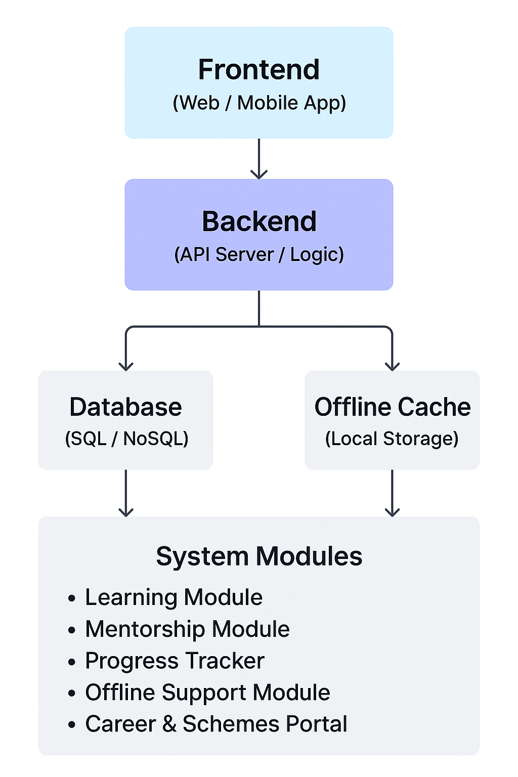
Architecture Diagram

Slide 21
Modules
1) User Authentication & Roles
Separate login for students, teachers, and admins.
Role-based access (teacher can upload lessons, students can view, admin monitors usage).
2) Content Delivery Module
Offline-first digital lessons (PDF, audio, and video).
Local storage caching + sync when internet is available.
3) Assessment & Feedback Module
Quizzes and assignments (MCQ, short answer).
Automatic scoring + performance tracking.
4) Analytics & Reporting Module
Dashboard for attendance, lesson usage, and learning outcomes.
Reports exportable in CSV/PDF for NGOs or govt. officers.
5) Teacher Training Module
Micro-learning content for teachers.
.

Slide 22
Hardware and Software Details
Hardware:
Low-cost Android tablets / smartphones for students and teachers.
Raspberry Pi or Mini-PC for local offline content server.
Projector & speakers (optional) for group learning.
Solar battery backup / UPS for rural areas with power shortages.
Wi-Fi router or hotspot device for local content sharing.
Software:
Frontend: React (Web) / Flutter or React Native (Mobile).
Backend: Firebase (Firestore + Auth) or Node.js + Express + PostgreSQL.
Database: SQLite (offline) + cloud sync database.
Storage: Google Firebase Storage / AWS S3 for learning resources.
Other Tools:
GitHub/GitLab for version control.
Google Collab / Jupyter Notebook for initial analytics.
GanttProject / MS Project for project scheduling.

Slide 23
Github Link
The Github link provided should have public access permission.
GitHub Link
https://github.com/varsha12345170/rural-education-project

Slide 24
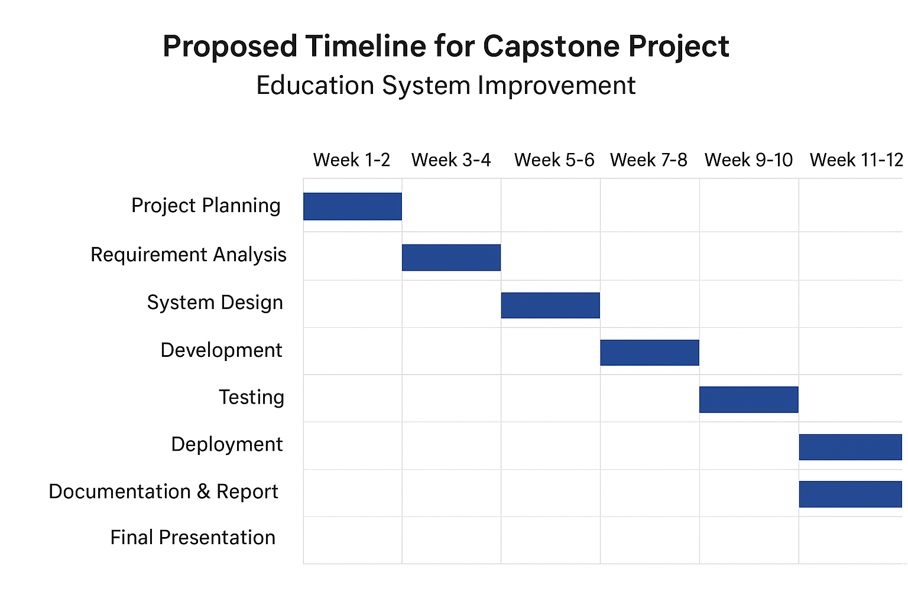
Timeline of the Project (Gantt Chart)

Slide 25
References (IEEE Paper format)
[1] https://ieeexplore.ieee.org/document/10772876
[2] https://ieeexplore.ieee.org/document/10531331
[3] https://ieeexplore.ieee.org/document/9711825

Slide 26


